Slide 1

@SharePointCincy
#SharePointCincy
Welcome to
Building Single Page Applications in SharePoint using AngularJS
Speaker: Steve Pietrek (@spietrek)
References:
https://github.com/spietrek/SharePointCincy2015
https://github.com/spietrek/Cardinal.Projects
https://jsfiddle.net/spietrek/04y3zwo8/2

Slide 2


@SharePointCincy
#SharePointCincy
Conference Hosts

Slide 3





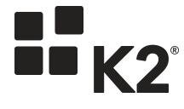





@SharePointCincy
#SharePointCincy
PLATINUM SPONSOR
GOLD SPONSORS
EXHIBITORS

Slide 4



@SharePointCincy
#SharePointCincy
 | Open wireless access is available.
 | See something remarkable? Tweet (#SharePointCincy) and share it during the session!
 | Facebook User? Post your comments to our new Facebook Group Page. Just look for SharePoint Cincy.
Notes:
Twitter

Slide 5
Agenda
SPA Overview
AngularJS Overview
SharePoint Development Challenges
SharePoint Data Access
Projects Demo
Deployment
Tools
Best Practices & Gotchas

Slide 6
Single Page Applications

Slide 7
Single Page Applications
Goal:
Provide a desktop-like rich user experience
Attributes:
Entire site content loads within a single HTML page
Only areas of the site will reload based on user actions. No URL change except for hash (#).
State maintained on client
Presentation layer can be completely decoupled from backend layer
Main technologies: HTML, CSS, JavaScript, AJAX, web services (e.g. REST)
Benefits:
Performance
Maintainability (if you leverage a framework)
Code reuse
Team-friendly

Slide 8
AngularJS Overview

Slide 9
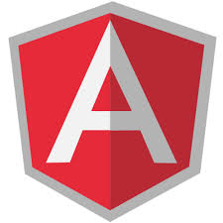
What's AngularJS?
"Superheroic JavaScript MVW Framework"
Structural JavaScript client-side framework for building dynamic web apps (using HTML and JavaScript)
Empowers traditional HTML
Extend HTML's syntax to express your application's components clearly and succinctly
Backed by Google and the community
Open source (MIT License)
Vibrant community (books, Stack Overflow, blogs, plug-ins, resources, etc.)
** Great framework for building single page applications
** My opinion

Slide 10
AngularJS Main Features
Backed by Google & Community
MV*
Dependency Injection
Testing
jqLite
Templates
Modules
Controllers
Filters
Providers
Form Validation
Routing
Two-way Data Binding
Directives
Great for SPA’s

Slide 11
AngularJS Implementation of MV*
Browser
User Interaction (Routes & Behaviors)
Controller
(Logic/ Behaviors)
Model
(Provider)
RESTful Web Service
DOM
View
(UI)
$scope

Slide 12
Filters
Formats the value of an expression displayed to users
OOTB examples include:
currency, date, filter, json, limitTo, lowercase, number, orderBy, uppercase
Chain multiple filters using |
Create custom ones as well
Yes, there is a "Filter" Filter
ng-repeat="president in demo.presidents | orderBy:'name'"
ng-repeat="president in demo.presidents | filter:demo.name"
<li ng-repeat="president in demo.presidents | orderBy:'name' | filter:demo.name">
{{president.name | uppercase}}
</li>

Slide 13
AngularJS Demo https://jsfiddle.net/spietrek/04y3zwo8/2

Slide 14
Providers
Singleton objects
Keep data around for lifetime of application
Separation of concerns
Logical place to access external data ($http or $resource)
Preferred method to communicate between controllers
Yes, there is a "Provider" Provider
Constant
Value injected anywhere
Value
Simple injectable value
Factory
Injectable function
Service
Injectable constructor
Provider
Configurable factory
Notes:
http://blog.xebia.com/2013/09/01/differences-between-providers-in-angularjs/

Slide 15
Directives
Many out-of-box directives (e.g. ng-app, ng-repeat, ng-model, ng-controller, etc.)
Allow you to extend HTML vocabulary for your application
HTML annotations that trigger JavaScript behaviors
Extend attributes, elements, classes, or comments
Function that runs when the compiler encounters it in DOM
DISCLOSURE: Most complex area in AngularJS. Important to learn for code reuse and separation of concerns.

Slide 16
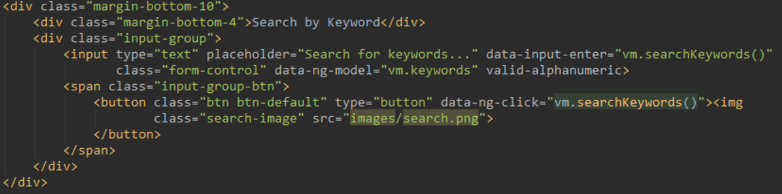
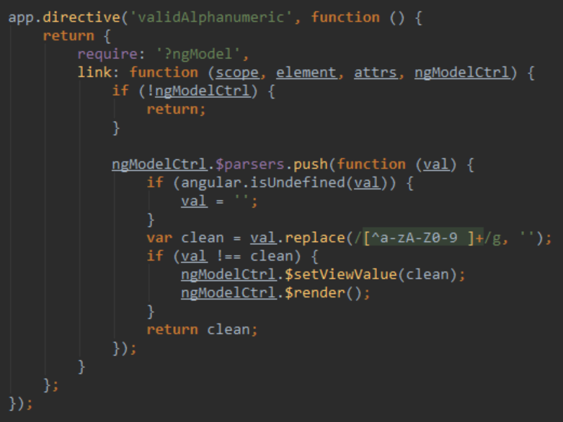
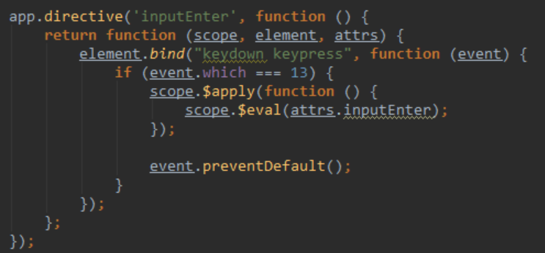

Slide 17
SharePoint Development Challenges

Slide 18
SharePoint 2007 Challenge
Full Trust applications
Code affects the whole farm
Developers build custom solutions
Administrators can only secure solutions with Code Access Security (CAS)
Hard to control what is in custom code (e.g. Elevated Privileges)
Biggest cause of SharePoint support cases: Custom code
Developer
Administrator
Site Collection Owner
Activate and use customizations
Design, build, and test customizations
Install and monitor customizations

Slide 19
SharePoint 2010 Challenge
Developer
Administrator
Site Collection Owner
Install customizations
Design, build, and test customizations
Set quotas and monitor customizations
Activate and use customizations
Sandbox solutions applications
Code affects the site collection
Developers build custom solutions
Administrators define quotas and use resource monitors to check site collection usage
Site collection owners deploy, activate, and implement the customizations
Missing functionality in Sandbox Solutions

Slide 20
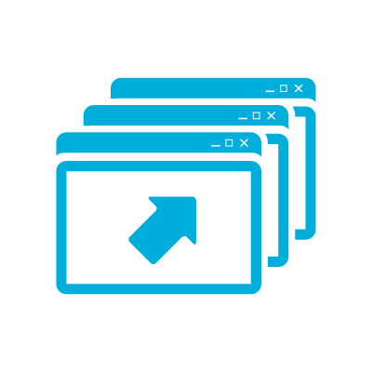
"Traditional" SharePoint Development Challenges
Performance and Stability
Lifecycle Management
Not Cloud Ready
Resources
Notes:
Challenges
Difficultly finding qualified resources
Steep learning curve
Performance and stability issues
Requires deployment by Farm Administrators
Lifecycle management
Not cloud ready
What is a SharePoint 2013 App?
Web application that runs “OUTSIDE” of SharePoint
Uses Client OM to talk to SharePoint (JS, REST/CSOM)
Is the future proof way to add new capabilities to SP2013+
Is available from the Corporate App Catalog or SharePoint Store
Is easy to install by site owners or Tenant/Farm administrators

Slide 21
Benefits of SharePoint 2013 App Model
Infrastructure
Developers
Users
Isolation & multitenant
Reduces risk to farm
Simplifies SharePoint upgrades
Cloud ready
Corporate App Catalog facilitates governance
Larger developer reach
Use industry standards
Use non-SharePoint technologies
Lifecycle management (development, deployment, versioning, upgrades)
Based on familiar app model
Apps can be downloaded from SharePoint Store or Corporate App Catalog
Notes:
Challenges
Difficultly finding qualified resources
Steep learning curve
Performance and stability issues
Requires deployment by Farm Administrators
Lifecycle management
Not cloud ready
What is a SharePoint 2013 App?
Web application that runs “OUTSIDE” of SharePoint
Uses Client OM to talk to SharePoint (JS, REST/CSOM)
Is the future proof way to add new capabilities to SP2013+
Is available from the Corporate App Catalog or SharePoint Store
Is easy to install by site owners or Tenant/Farm administrators

Slide 22
Why not use the SharePoint 2013 App Model?
"Native" JavaScript provides a "quicker" development experience
Leverage other IDE's such as WebStorm and Brackets
Configuring the on-premise App Store can be painful
Deploy to a site without permissions to App Store
App parts run as iframe which don't scroll in iOS
Note: Port a "Native" JavaScript application to SP2013 App Model (and vice versa)

Slide 23
SharePoint Data Access

Slide 24
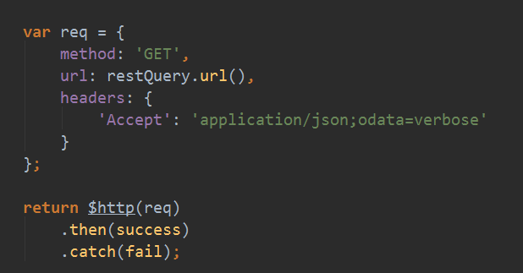
SharePoint 2013 REST
Use jQuery AJAX or AngularJS $http
Best practices
Use Postman or Fiddler to execute and test queries
Set the Accept header
Only retrieve what you need by using $select and $filter.
“Chunky, not chatty”

Slide 25
Projects Demo

Slide 26
Deployment

Slide 27
Deployment Workflow
Create Custom Page Layout
Upload Source Code to Pages library
Style and script references
Base HTML referencing ng-app
Same folder structure as local environment
Upload source code
SharePoint Deployment & Test
Enable Publishing features
Upload to Master Page Gallery
Update and upload custom page (if necessary)
Upload source code to Pages library
Local Test
Gulp tasks
Functional testing
Disable web security (--disable-web-security) errors in Chrome
Functional testing
Only the build files are needed
Update page layout (if needed)

Slide 28
Tools

Slide 29
Tools
IDE: Visual Studio, WebStorm, Brackets, Atom, Sublime Text
Third-party JavaScript frameworks: jQuery, Bootstrap, Moment, DataTables, ng-tasty, Font Awesome, SPServices, lodash
Browser Plug-ins: Firebug, Batarang, Postman
Task Runners: Gulp, Grunt
Package Managers: npm, Bower
Source control: Git, Visual Studio Online
Other tools: Node.js, Fiddler, Karma, Jasmine, PhantomJS

Slide 30
Best Practices & Gotchas

Slide 31
Best Practices
Filter data to reduce data loads
Group by function, not component type
Name your files by function (e.g. projects, dashboard, admin)
Group all files together (module, controllers, services, directives, unit tests, end-to-end tests)
Only one controller per view. Share data between controllers using services.
Organize code: John Papa’s Angular Style Guide http://goo.gl/xljmi6
Build and deploy often!!!
Write unit tests
Test in different browsers

Slide 32
Gotchas
Issue | Workaround
SharePoint Item-limit Threshold | Split data into separate lists or libraries. Add indexes to columns where you want to filter.
SharePoint Security | Apply security at the site or list levels. If possible, avoid item-level permissions. Use Search API to aggregate across sites and lists.
CSS Overrides | SharePoint default CSS may cause style issues. Deploy to SharePoint and test using different browsers. Update CSS to run the same in local environment.
AngularJS Controller Bloat | Use directives to manipulate DOM. Data should be stored in services.
AngularJS Performance | Avoid 2000 watchers on page (may be higher in 1.3). Use Batarang to search for duplication. Use bind once for expressions which do not change.
Dependencies | Review dependencies whenever upgrading tools.
Frameworks | "Framework of the week"

Slide 33
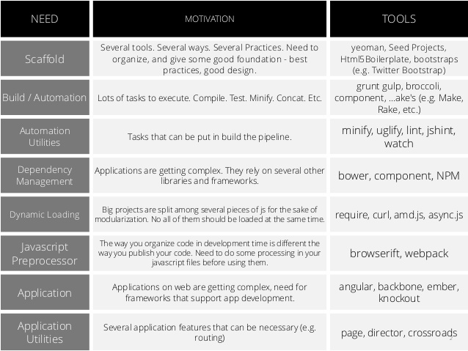
** Slide from Marcos Vinícius

Slide 34
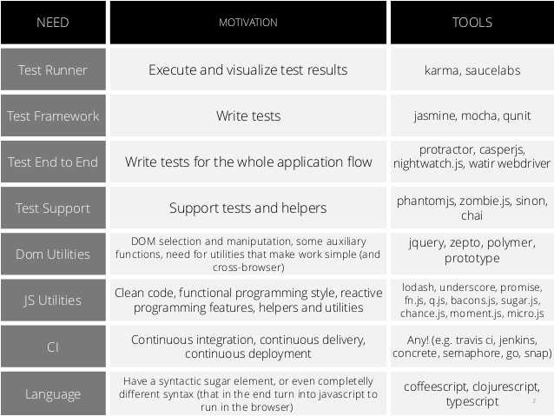
** Slide from Marcos Vinícius

Slide 35


@SharePointCincy
#SharePointCincy
 | Remember to visit the exhibit hall.
 | Get to know your user groups to find out about local activities and events in your area.

Slide 36
@SharePointCincy
#SharePointCincy
PLATINUM SPONSOR
GOLD SPONSORS
EXHIBITORS

Slide 37
Offline Slides

Slide 38
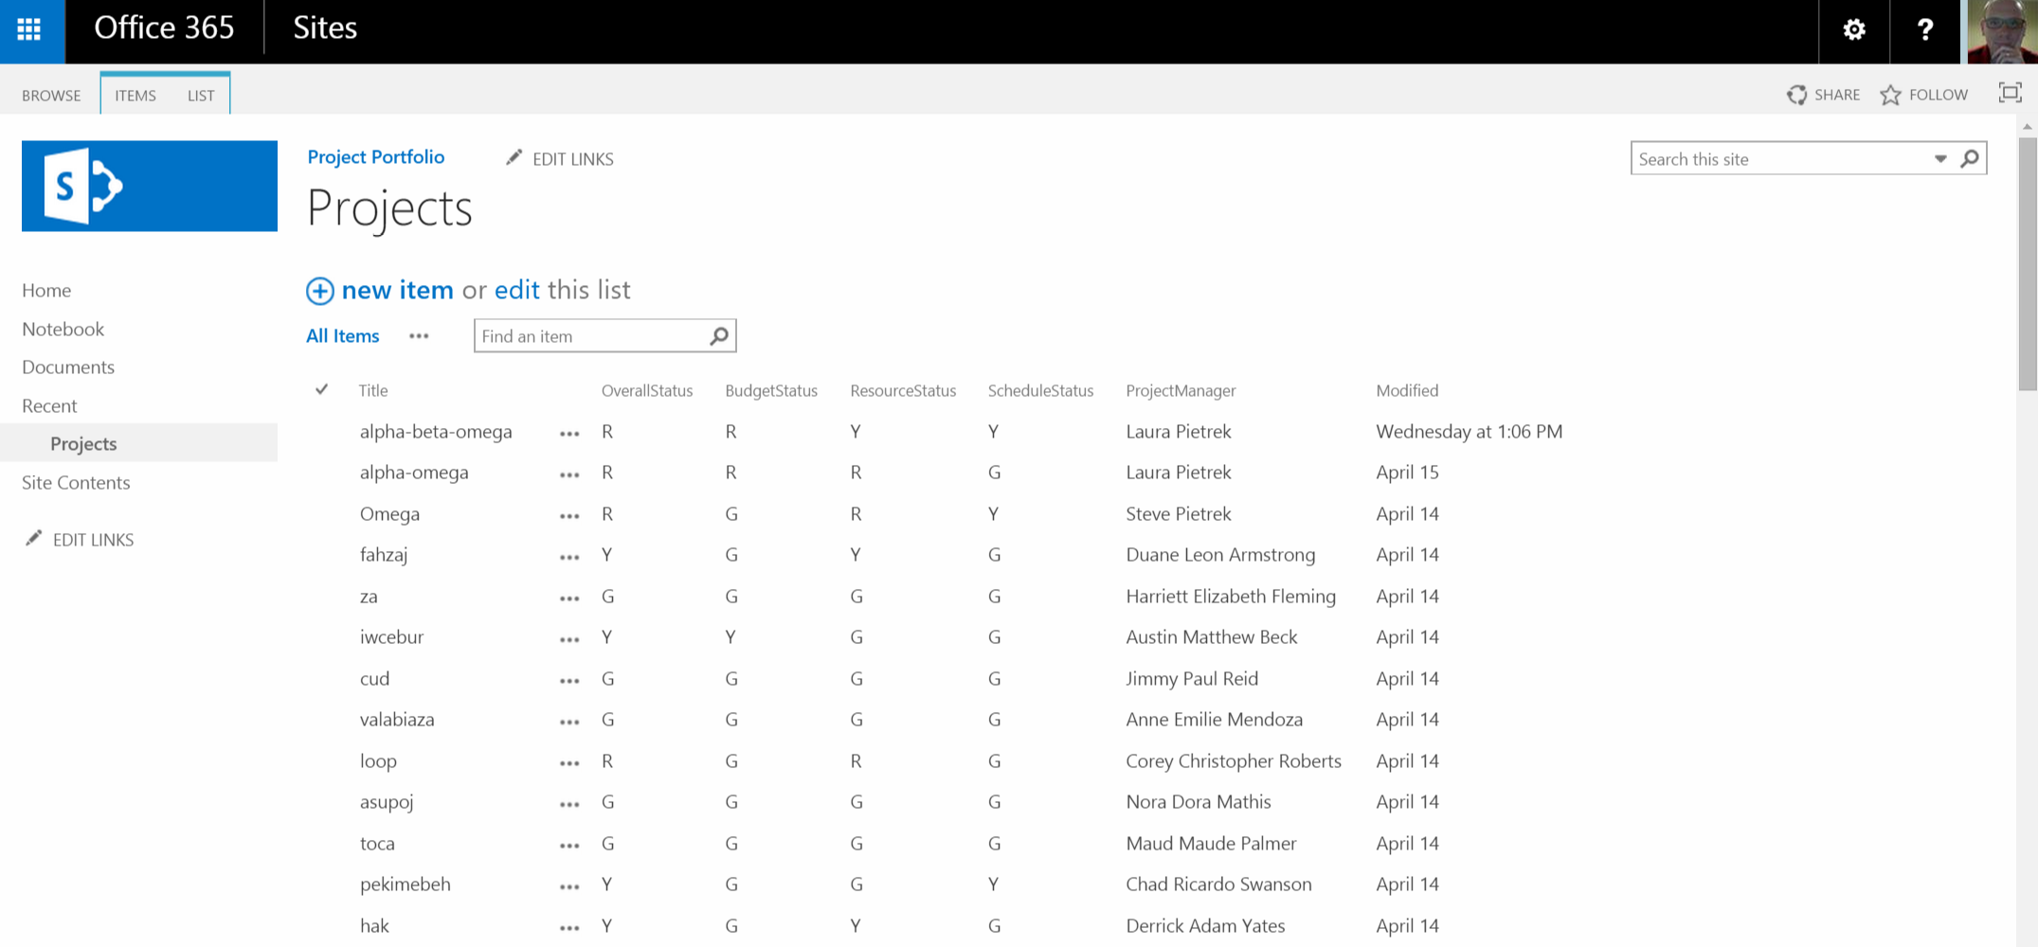

Slide 39
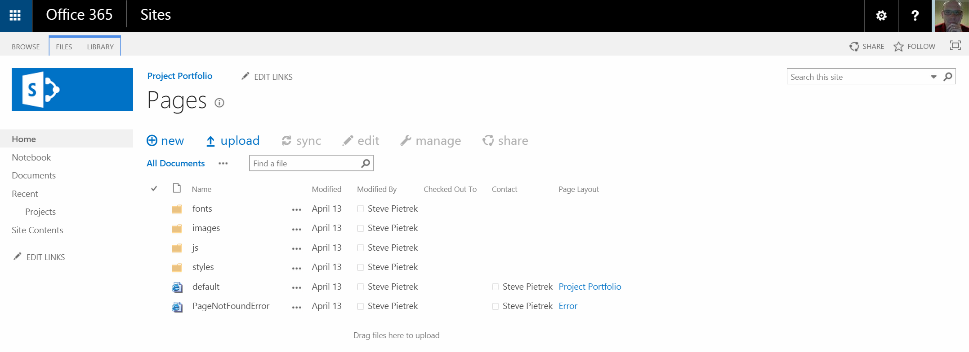

Slide 40
